Slide 1
MOOSE and friends: Building data-driven multiscale models
Upi Bhalla
NCBS-TIFR
Bangalore, India

Slide 2
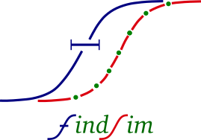
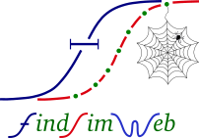

MOOSE and friends
MOOSE: Runs multiscale models.
Rdesigneur: Concise Python definition of multiscale models.
FindSim: Codifies experiments, runs them on models, scores results
FindSimWeb: Does the same from a web interface.
Also manages database of coded experiments.
HOSS: Hierarchical Optimization of Systems Simulations.
HILLTAU: Simulator and format for reduced signaling models: accurate, sparse, and fast
SANKET: Signalling and Neurophysiology Knowledge-resource for Experiments and Theory
>250 experiments and analysis pipeline using FindSim and HOSS

Slide 3
The Multiscale Object-Oriented Simulation Environment
GPL
C++/Python/Qt/GSL/OpenGL
https://github.com/BhallaLab/moose
https://moose.ncbs.res.in

Slide 4
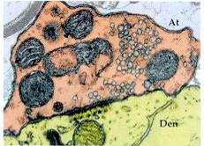
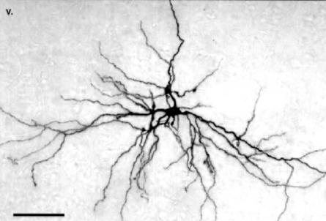
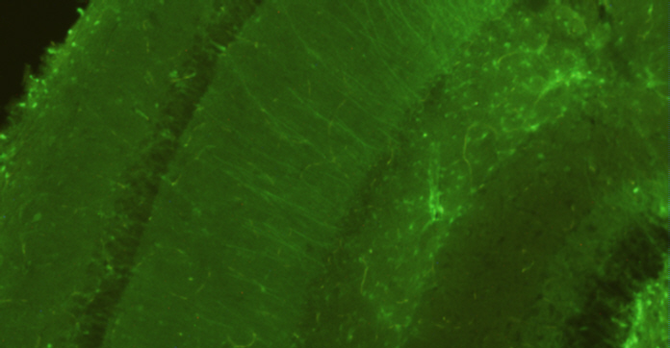
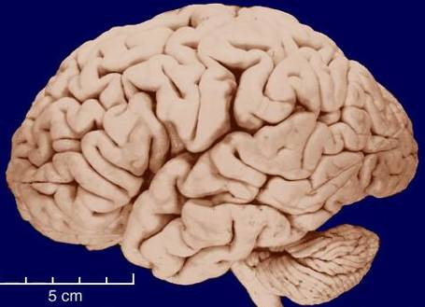
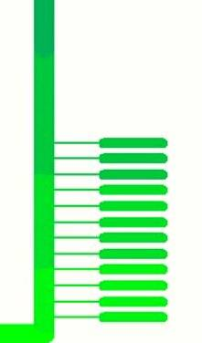
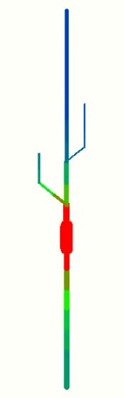
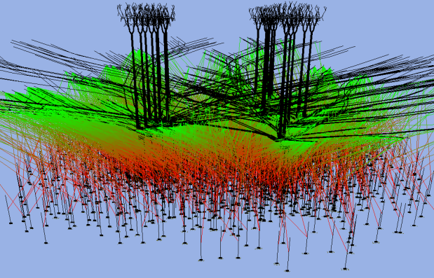
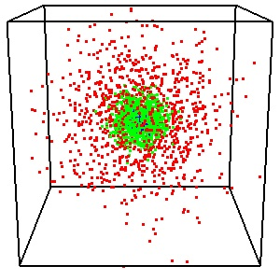
Methodology: Modeling across scales with MOOSE
Growth
Factor
Glu
Regulator/
Hormone
Glu
RTK
mGluR
GPCR
NMDAR
Gq
Gs α
α
βγ
PLCβ
PLCγ
Grb
IP3
DAG
SoS/GEF
Ca
Ca
PKC
Ras
AC
PDE
CaM
CaMKII
AA
cAMP
CaN
PLA₂
MAPK
PKA
PP1
cascade
MKP-1
Stochastic
Compartmental
ODE and stochastic
Steady-state solver
Cellular biophysics
Network
Multiscale: biophysical network
Multiscale: Rdesigneur

Slide 5
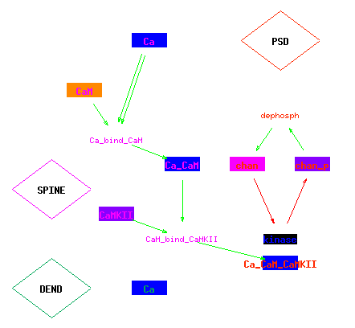
Multiscale example: Bistability due to receptor phosphorylation feedback

Slide 6
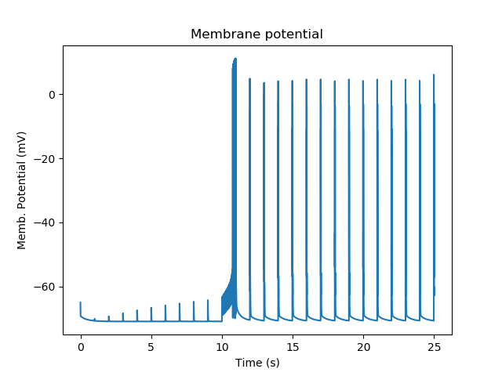
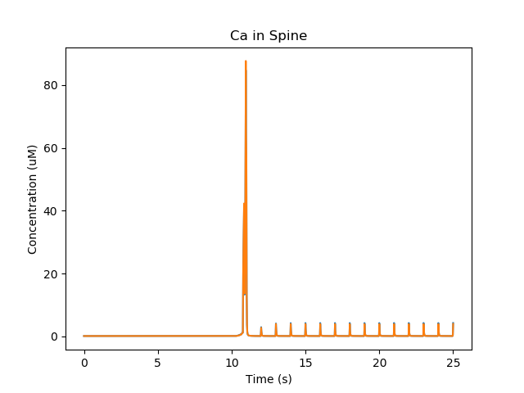
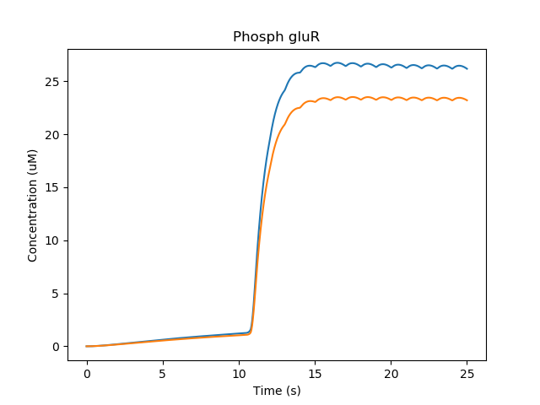
Multiscale example: Bistability due to receptor phosphorylation feedback
Synaptic input -> NMDAR ->
Ca -> CaMKII -> translocation to PSD -> GluR phosphorylation -> Greater conductance ->
More depolarization on synaptic input ->
more Ca input through NMDAR

Slide 7
Defining multiscale models: rdesigneur
Soma excitability
Molecular transport
Dendritic excitability
Insert spines
Spine structural change
Protein synthesis, turnover
Synaptic input
Diffusion
Signaling all over

Slide 8
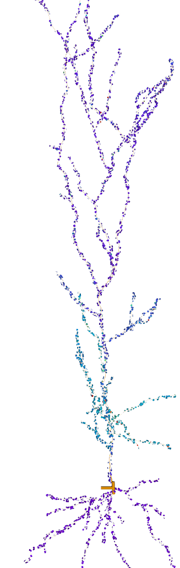
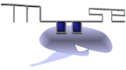
Example multiscale model
Morphology from Hippocampal CA1 pyramidal neuron
NeuroMorpho.org
>3000 morpho compartments, ion channels in each
~5000 spines
Full reaction set in each spine and morpho compartment
Background synaptic input at 0.1 Hz
Patterned synaptic input on groups of spines -> Ca influx
Ca -> signaling, signaling -> channel modulation
http://Moose.ncbs.res.in
Bhalla, eLife 2017
Dan Johnston

Slide 9
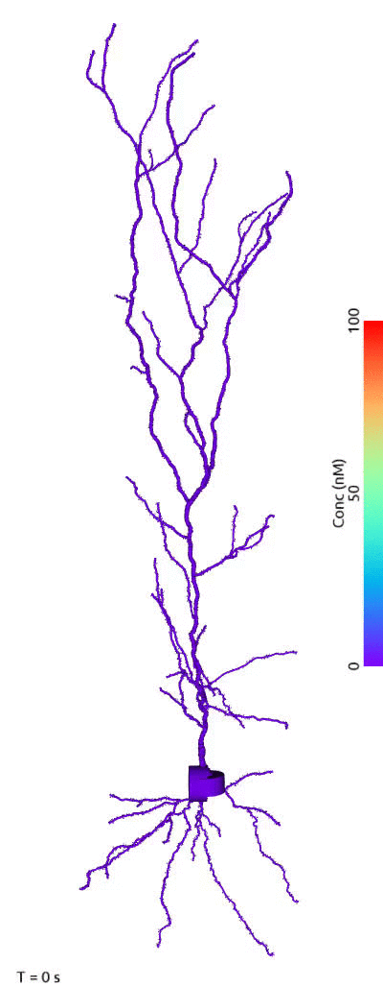
Emergence: Sequence selectivity
Sequential
Scrambled
Bhalla, eLife 2017

Slide 10
Complexity
13000 electrical segments
5 ion channels each
3 kinds of receptors on each spine
16000 chemical voxels
50 reactions
6 electrical segments
4 ion channels
2 kinds of receptors
60 chemical voxels
8 reactions

Slide 11
Complexity
Change 3 lines in Rdesigneur:
Cell morphology prototype
Chemical system prototype
Deliver stimulus more focally

Slide 12
Speed
13000 electrical segments
5 ion channels each
3 kinds of receptors on each spine
16000 chemical voxels
50 reactions
900x slower than real-time (without parallelization)
6 electrical segments
4 ion channels
2 kinds of receptors
60 chemical voxels
8 reactions
5x faster than real-time

Slide 13
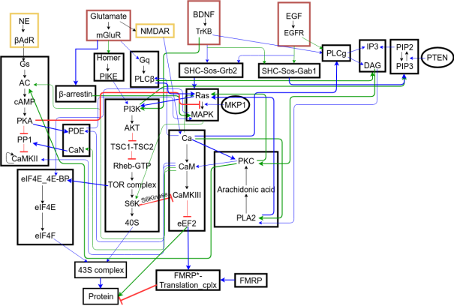
Simulator and model builder are only a small part of the workflow.
Make and run model

Slide 14
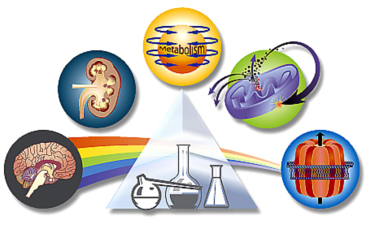
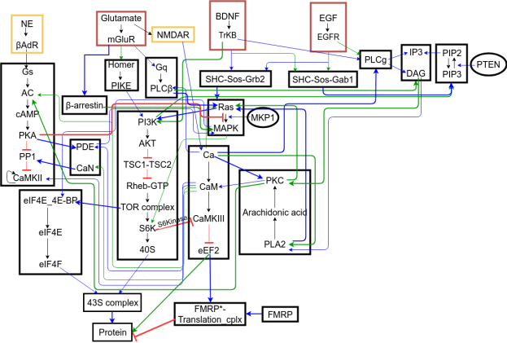
Workflow
Pick processes
Make and run model
Get data, organize it
Optimize model
Use model

Slide 15
MOOSE and friends
MOOSE: Runs multiscale models.
Rdesigneur: Concise Python definition of multiscale models.
FindSim: Codifies experiments, runs them on models, scores results
FindSimWeb: Does the same from a web interface.
Also manages database of coded experiments.
HOSS: Hierarchical Optimization of Systems Simulations.
HILLTAU: Simulator and format for reduced signaling models: accurate, sparse, and fast
SANKET: Signalling and Neurophysiology Knowledge-resource for Experiments and Theory
>250 experiments and analysis pipeline using FindSim and HOSS

Slide 16
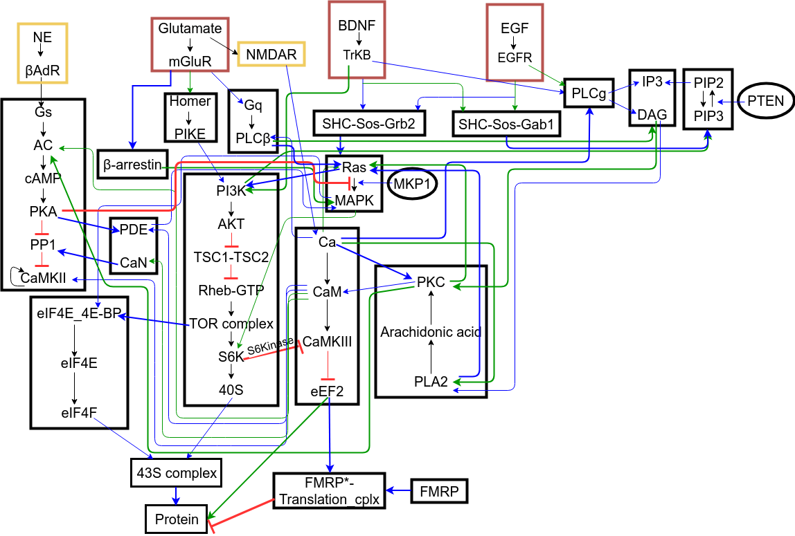
Consider a pathway model
Block diagram for the post-synaptic translation network
16

Slide 17
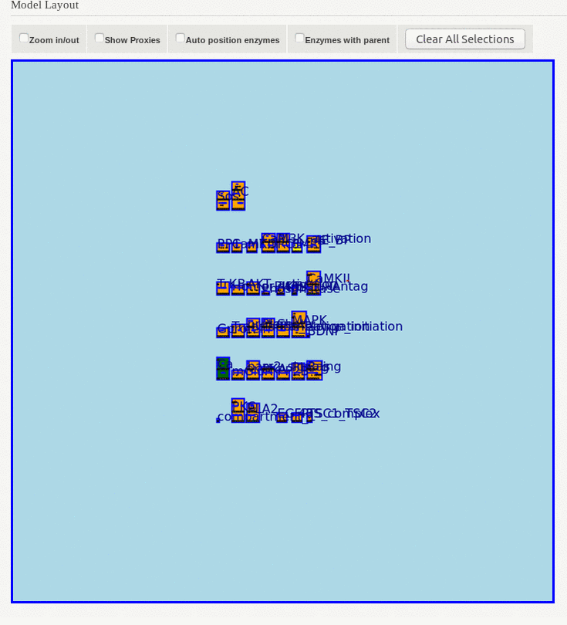

Slide 18
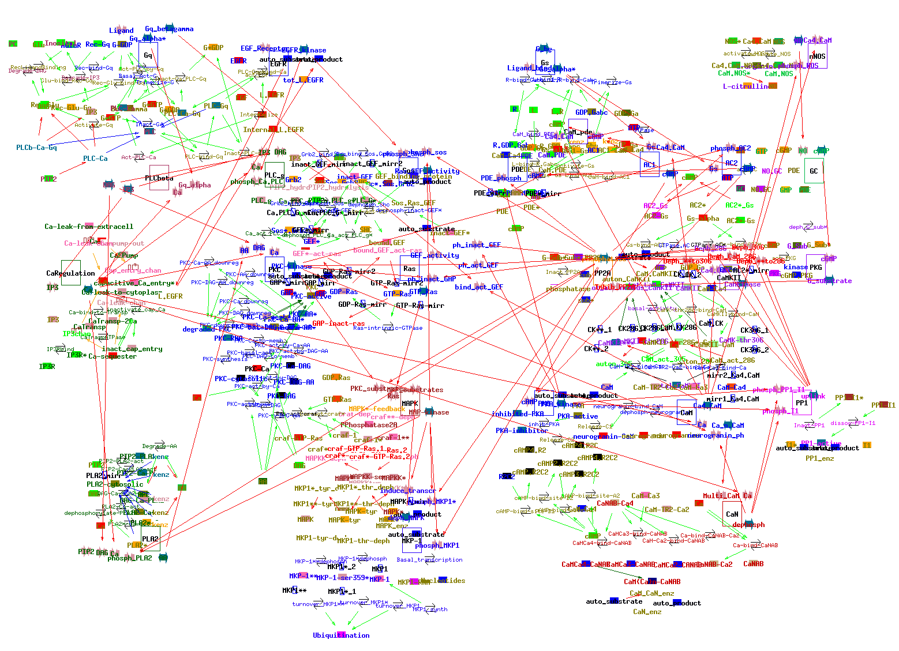
Much older, much smaller model
Bhalla and Iyengar, Science 1999

Slide 19
Why have we been stuck?
Computer power
Simulator capabilities
Experimental techniques
It is hard to hand-craft models
It is hard to re-derive them
Cross-talk limits modularity
Systematic data gathering is costly and boring

Slide 20
Workflow
Pick processes
Make model
Get data
Optimize model
Use model

Slide 21
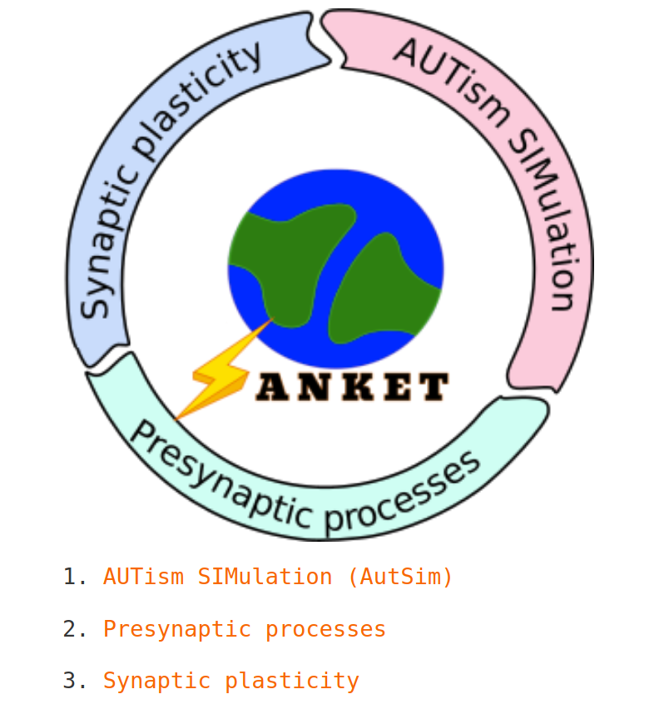
Members Institution
Upi Bhalla NCBS Bangalore
Aditi Bhattacharya InStem Bangalore
James Chellaiah JNCASR Bangalore
Deepak Nair IISc/CNS Bangalore
Shailesh Appukuttan CNRS France
Sourav Bannerjee NBRC Manesar

Slide 22
Workflow
Pick processes
Make model
Get data
Optimize model
Use model

Slide 23
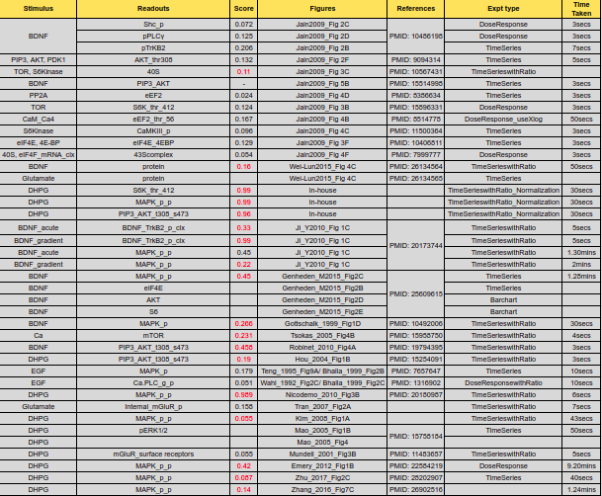
Experiments: published
~ 260 curated experiments used to build and constrain model
23

Slide 24
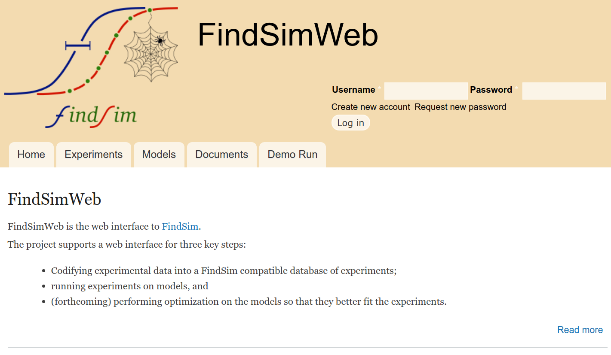
https://findsimweb.ncbs.res.in

Slide 25
Workflow
Pick processes
Make model
Get data
Optimize model
Use model

Slide 26
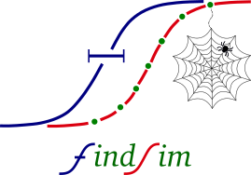
Components to optimize model
MOOSE: Runs multiscale models.
FindSim: Codifies experiments, runs them on models, scores results
FindSimWeb: Does the same from a web interface.
Also manages database of coded experiments.
HOSS: Hierarchical Optimization of Systems Simulations.
Deploys FindSim in parallel and in stages to tune model
Prototype launcher from FindSimWeb to NSG and in-house clusters

Slide 27
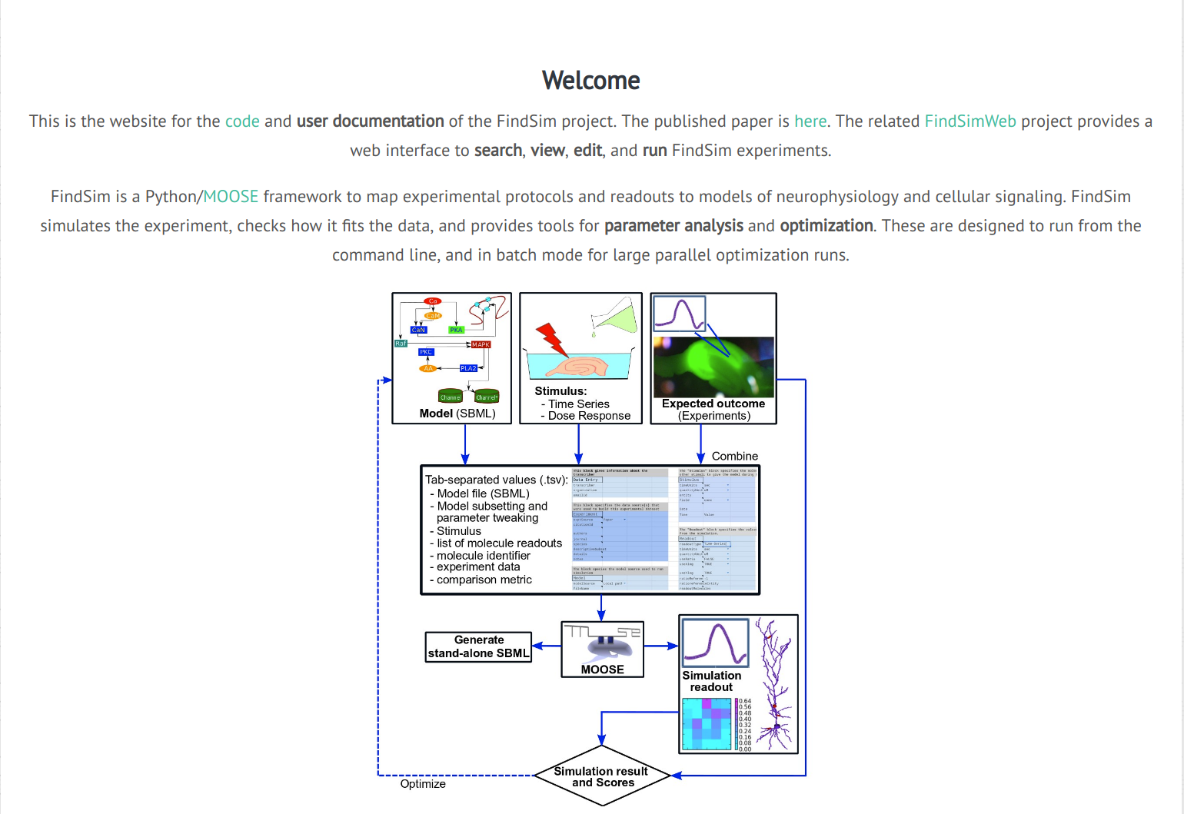
Framework for Integrating Neuronal Data and SIgnaling Models
https://findsim.ncbs.res.in

Slide 28
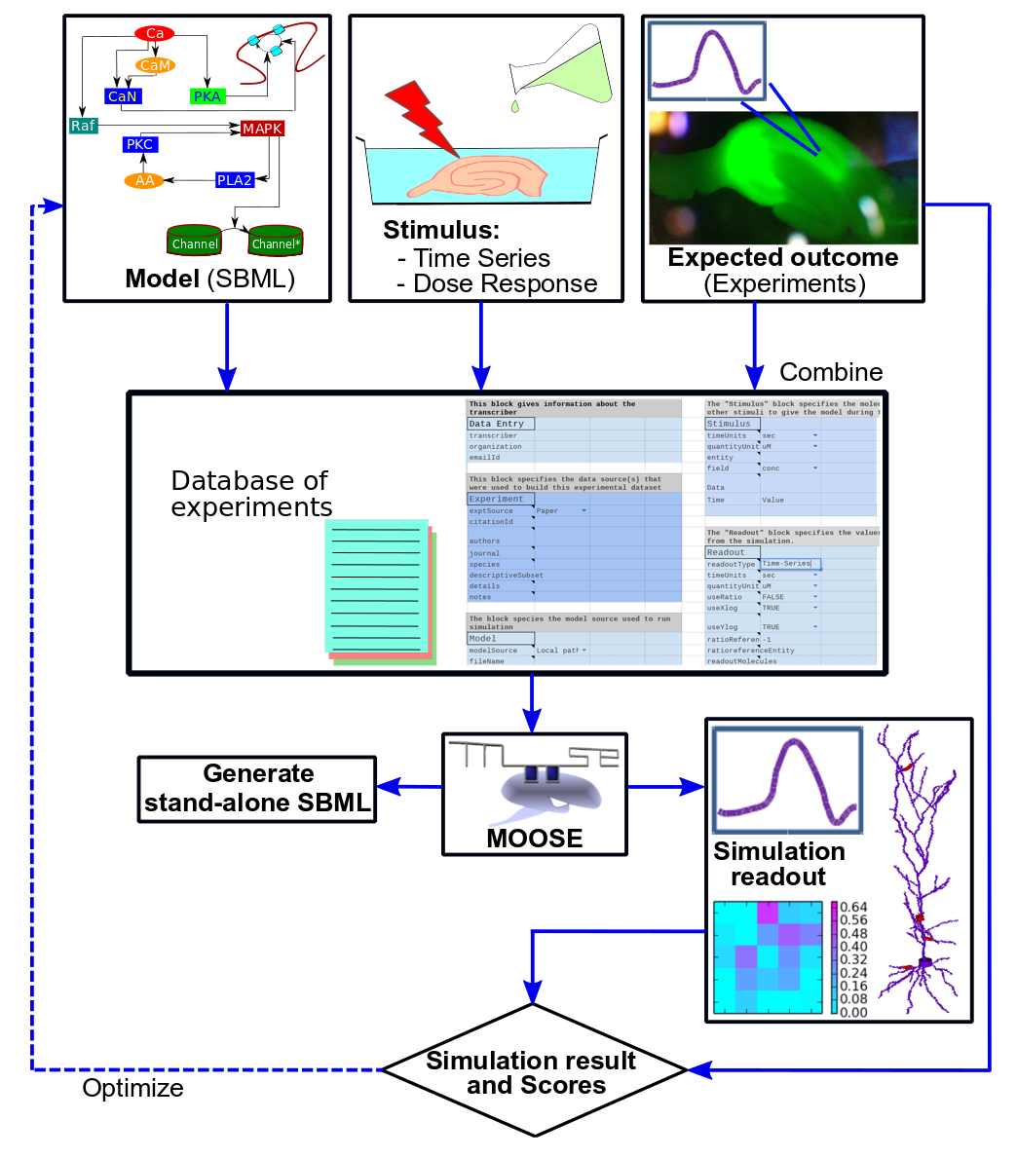

Flowchart
[Viswan NA, HarshaRani GV et al.,2018]
28

Slide 29
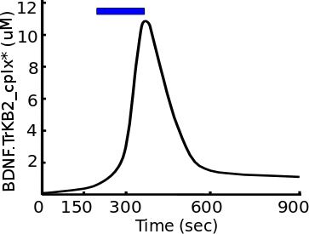
FindSim: Experiment types
a) Time Series
[Viswan NA, HarshaRani GV et al.,2018]
29

Slide 30
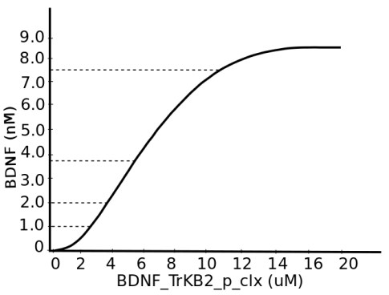
FindSim: Experiment types
Types of experiments
BDNF_TrKB_p_clx (uM)
a) Time Series
BDNF (nM)
b) Dose Response
[Viswan NA, HarshaRani GV et al.,2018]
30

Slide 31
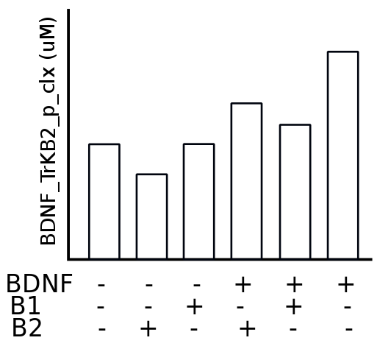
FindSim: Experiment types
Types of experiments
BDNF_TrKB_p_clx (uM)
a) Time Series
BDNF (nM)
b) Dose Response
c) Bar Chart
[Viswan NA, HarshaRani GV et al.,2018]
31

Slide 32
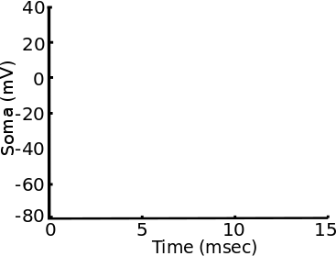

FindSim: Experiment types
Types of experiments
BDNF_TrKB_p_clx (uM)
a) Time Series
BDNF (nM)
b) Dose Response
c) Bar Chart
d) Current/ Voltage clamp
[Viswan NA, HarshaRani GV et al.,2018]
32

Slide 33
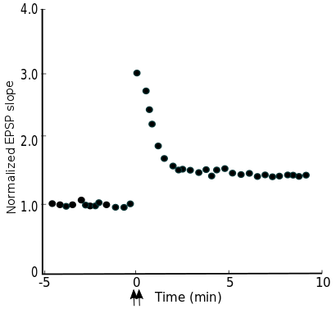
FindSim: Experiment types
Types of experiments
BDNF_TrKB_p_clx (uM)
a) Time Series
BDNF (nM)
b) Dose Response
c) Bar Chart
d) Current/ Voltage clamp
4.0
3.0
2.0
1.0
0.0
Normalized EPSP slope
-5 0 5 10
Time (min)
e) EPSP/EPSC
33
[Viswan NA, HarshaRani GV et al.,2018]

Slide 34
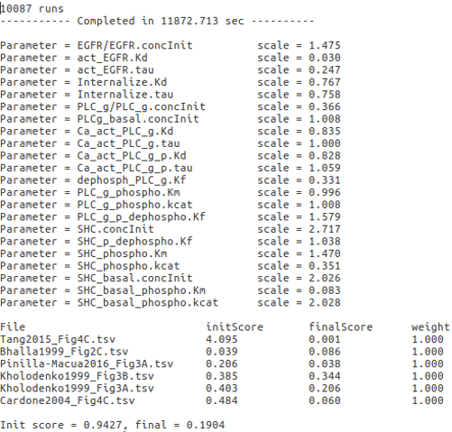
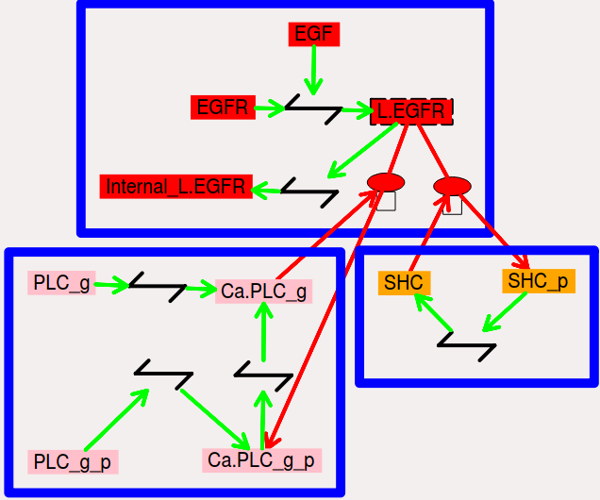
Example of Optimization
Init score = 0.9427, final = 0.1904
34

Slide 35
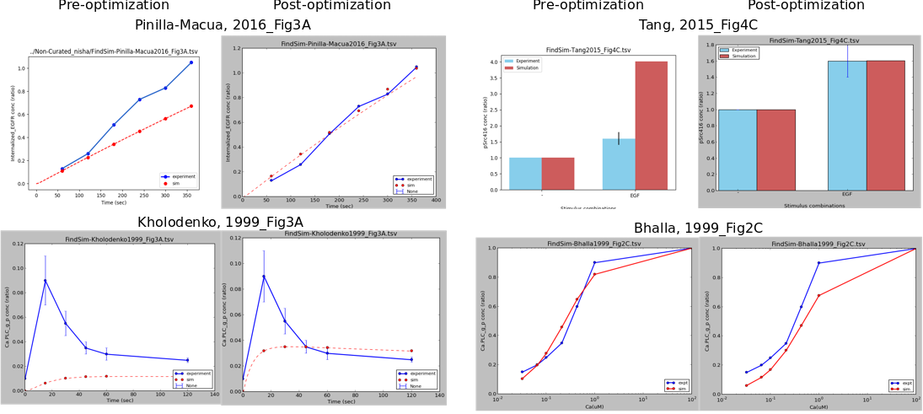
Testing the fitted model
Score=0.206
Score=0.038
Score=4.095
Score=0.001
Score=0.403
Score=0.206
Score=0.039
Score=0.086
35

Slide 36



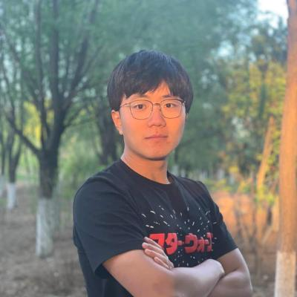

Coming soon: Farm optimization jobs to NSG from FindSimWeb
Hou Chen [Peking university, China]
Surbhit Wagle [NCBS, India]

Slide 37
Workflow
Pick processes
Make model
Get data
Optimize model
Use model

Slide 38
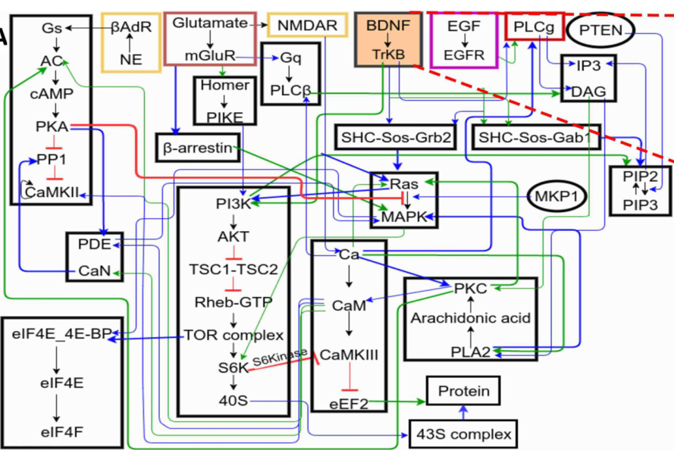
Using model: Fragile-X and autism
Known level differences between WT and Fragile-X patients

Slide 39
Using model: Put it back in physiological context
Detailed physiology:
Analysis of single-neuron phenotypes and responses to treatment
Reduced physiology:
Components of network models of mutant physiology

Slide 40
MOOSE and friends: Workflow for developing and using models
MOOSE: Runs multiscale models.
Rdesigneur: Concise Python definition of multiscale models.
FindSim: Codifies experiments, runs them on models, scores results
FindSimWeb: Does the same from a web interface.
Also manages database of coded experiments.
HOSS: Hierarchical Optimization of Systems Simulations.
HILLTAU: Simulator and format for reduced signaling models: accurate, sparse, and fast
SANKET: Signalling and Neurophysiology Knowledge-resource for Experiments and Theory
>250 experiments and analysis pipeline using FindSim and HOSS

Slide 41
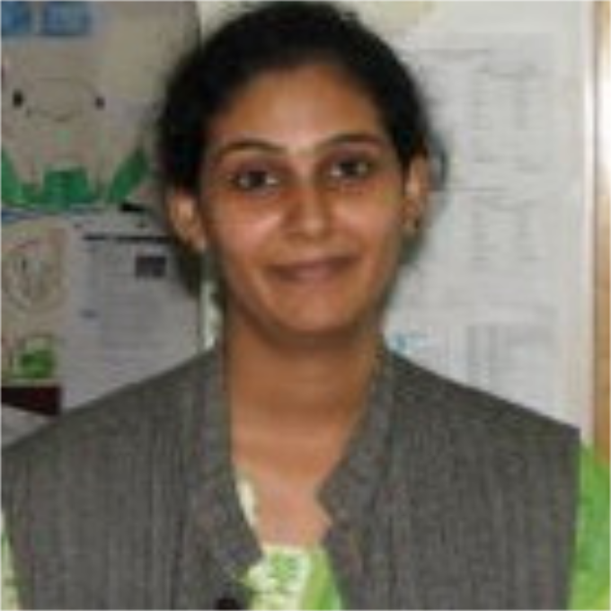
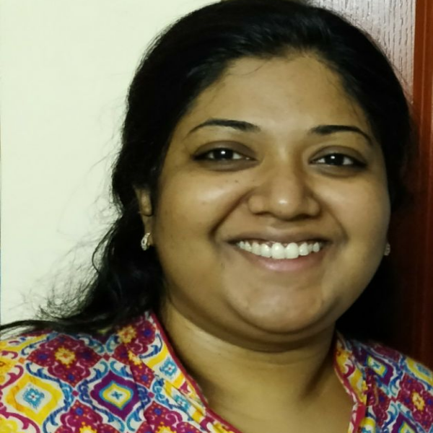
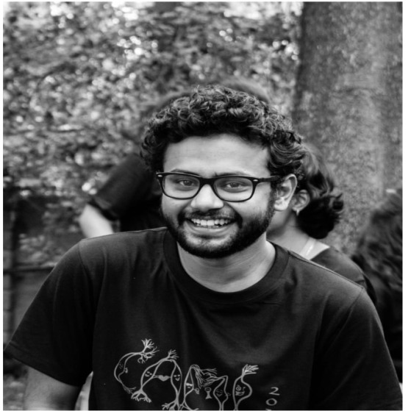
Acknowledgements
Harsha Rani, Nisha Viswaan, Surbhit Wagle
Jyoti Mangal, Vinod Ugale, Hou Chen, GSOC, INCF, NSG
Dr. Aditi Bhattacharya and Dr. Melanie Stefan
SANKET consortium members
UGC funding : UGC ISF Grant F-18/2014(IC)
DBT funding
MOOSE grant : DST Grant SR/CSI/66/2013
Super Computer facility, NCBS
41

Slide 42
MOOSE and friends
MOOSE: Runs multiscale models.
Rdesigneur: Concise Python definition of multiscale models.
FindSim: Codifies experiments, runs them on models, scores results
FindSimWeb: Does the same from a web interface.
Also manages database of coded experiments.
HOSS: Hierarchical Optimization of Systems Simulations.
HILLTAU: Simulator and format for reduced signaling models: accurate, sparse, and fast
SANKET: Signalling and Neurophysiology Knowledge-resource for Experiments and Theory
>250 experiments and analysis pipeline using FindSim and HOSS

